Slide 1
SAFR SCAN Training
Course SST101
Introduction

Slide 2
Introduction to SAFR SCAN
This section provides the SAFR SCAN elevator pitch and follows with full list of important features in SAFR SCAN. It closes with a spotlight on the key features.
Notes:
Identify the reasons why SAFR SCAN works indoors & outdoors in extreme lighting & temperatures.
[X] Direct control over camera (not an OEM bolt-on)
[ ] Multi-exposure true WDR (Wide Dynamic Range) scene prioritized camera.
[X] Fast face detection allowing real-time face-prioritized exposure adjustments.
[X] IR for finding and illuminating faces in low or zero light.
[X] White light allowing it to illuminate faces in zero or low light.
While high quality WDR, something our competitors tout for their camera, is a useful technology for capturing overall scene, it is inferior when the face is the only important area of interest.
Identify the reasons why SAFR has the lowest bias.
[X] Trained against a globally diverse data set.
[ ] Large model size.
[X] Face prioritized exposure to handle dark skin tones against strong backlight.
While large face models would allow for higher accuracy SAFR is known for its small model size and fast detection and recognition time.
Why is it beneficial to enroll from an image file or webcam?
[X] No need to enroll at device speeding up and reducing complexity of new deployments.
[X] Enables direct integration to existing PACS (simply sync your existing images).
------
You must enroll your face at the SAFR SCAN device in order to use the liveness verification features?
( ) True
(X) False
SAFR's unique advantage is being able to enroll from JPEG or Webcam image without requiring user to enroll on the device.
--------
X SAFR SCAN will work in direct sunlight conditions?
(x) True
() False
SAFR SCAN automatically adjusts the exposure by prioritizing the face as the target for adjustments. Resulting in ability to recognize even with direct sunlight.
--------
What applications come with SAFR SCAN?
[X] SAFR SCAN Web Console
[X] SAFR Server
[X] SAFR Desktop
[X] SAFR Mobile (Android or iOS)
[X] SAFR Server Web Console
[X] SAFR Actions
All of above are available for free with purchase of SAFR SCAN.
-----
SAFR Mobile can be used to manage person record and view events?
(X) True
( ) False
--------
X SAFR SCAN will not work in a dark hallway?
( ) True
(x) False
SAFR SCAN uses IR to detect faces in total darkness and can turn on white lights should face matching in infrared mode fail.
--------
X What features will be part of SAFR's Advanced Analytics subscription?
[X] Tailgating
[X] People Counting
[X] Audio Intercom
[ ] Synchronize with PACs
[ ] Wiegand and OSDP Output
--------
What Multi-Factor Authentication methods are available in SAFR SCAN?
[X] Mobile Credential
[X] Internal or External RFID Reader
[X] PIN
Other factors (QR Code and Intercom) will be available with future firmware release.
---
SAFR SCAN can integrate into your VMS in what way?
[X] Use SAFR SCAN as an additional IP Camera by connecting SAFR SCAN’s RTSP video streams.
[ ] Send Tailgating events to your VMS to trigger video recording.
[ ] SAFR SCAN does not integrate into VMS systems
-----
Anti-spoofing must be disabled to work with people wearing covid-19 masks.
( ) False
(X) True
SAFR SCAN can perform Anti-spoofing even if subject is wearing a mask.
-----
With SAFR Mobile Credentials, you must tap your phone to the reader to show intent and get access?
(X) False
( ) True
With SAFR SCAN Mob![<# alt text #>](file:///var/folders/t2/lrw7ms1x1j3c2x3mxv3bsjfh0000gn/T/com.skitch.skitch/DMDB9640E69-AC22-419D-A4CC-BFB27480FB55/KC_Questions.png "KC_Questions.png")ile Credentials you get the benefits of 2 factor authentication without having to take the phone our of your pocket. The mobile application runs in the background and credentials are transmitted at a distance of up to 20 feet.
------
Security - Match the descriptions with the security.
Data-at-Rest Security - SCAN uses AES-256 and RSA-2048 ciphers to encrypt data on disk.
Data-in-Transit Security - SCAN uses TLS 1.2/1.3 over https when transmitting data over network.
Data-in-process Security - Device has a secure boot that prevents rogue OS loading / tampering.
-----
Which of the following hosting options are possible with SAFR Server?
[X] On-Premises
[X] SAFR Cloud
[ ] Microservices
[X] BYOC (Bring your own cloud)

Slide 3
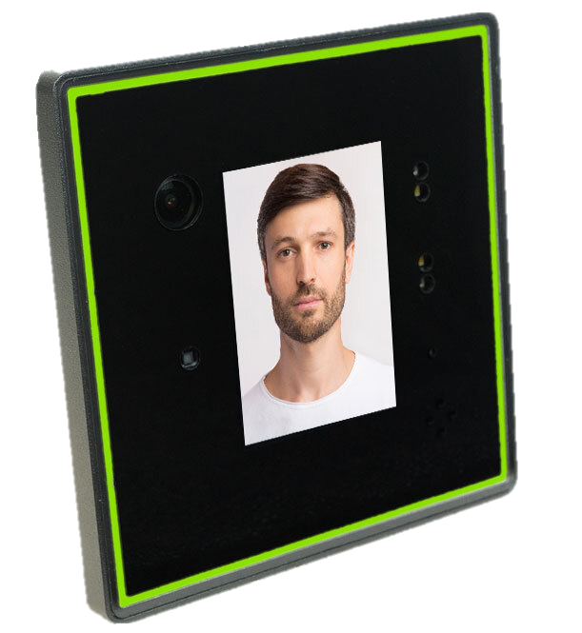
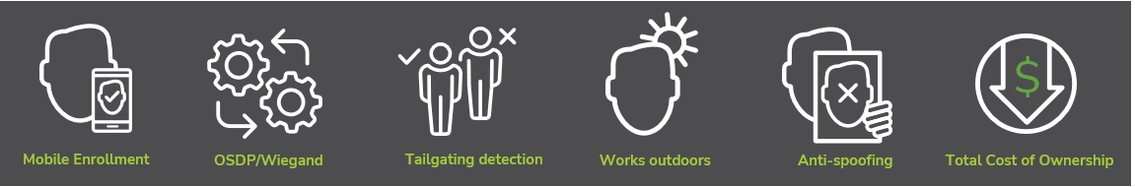


What is SAFR SCAN?
Facial Authentication Access Control Device
Secure, edge solution – all processing done on device.
Low total cost of ownership – door station, security camera and intercom all-in-one.
Most feature rich frictionless access control product on the market at a fraction of the cost of competitive solutions.
Made in the USA

Slide 4
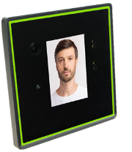
SAFR SCAN – The Elevator Pitch
Works indoors & outdoors in extreme lighting & temperatures
  Direct sunlight to pitch black, -40°F to 140°F (-40°C to 60°C)
Lowest Bias / High Accuracy
  Least variance across race and gender / Top 25 accuracy in NIST
Fastest and smallest face matching
  20ms detection time, 200ms match time
Flexible Enrollment Options
  Enroll from an image file, mobile, webcam or device
Integrates with standard Access Control Systems
  Wiegand/OSDP, Enrollment though PACS

Slide 5
SAFR SCAN – The Elevator Pitch Explained
Works indoors & outdoors in extreme lighting & temperatures
  Direct sun in foreground or background – Applies face prioritized exposure.
    Direct control over camera combined with fast detection allows it to adjust exposure to get proper exposure on face.
  Low / Zero light Environments – SAFR SCAN use a combination of strategies to handle low light.
    Applies IR illuminator to perform face recognition in low light for face detection.
    Gradually fades in white light on front panel to illuminate the face for matching.
Lowest Bias / High Accuracy matching
  SAFR is trained against a globally diverse data set and verified as having least variation (bias) across race and gender by NIST FRVT (Face Recognition Vendor Test Part 3 Demographics).
  Face prioritized exposure improves ability to handle dark skin tones under strong backlight conditions.
  99.87% LFW (labeled faces in the wild) matching accuracy / 99.85% for masked faces.
Fastest and smallest model in NIST FRVT
  20ms detection time / 200ms match time means SAFR makes multiple attempts to match face before other solutions make one attempt.
Enroll from an image file or webcam
  No need to enroll 3D face images on the device due to unique approach to
  anti-spoofing using a combination of 2D (texture and context) and 3D (face structure).
  You still have option to enroll on the device.
Integrates with standard Access Control Systems
  Import faces (with credentials) from access control systems without re-enrollment.
  Wiegand and OSDP Inputs and Outputs to transmit credentials.
  TTL Input/Output for controlling LEDs.

Slide 6
SAFR SCAN Features – Noteworthy
Self-contained
  Unlocks door even if network offline.
  Stores identities and performs face matching on-board.
  Embedded algorithm for fast and accurate operation.
Mobile credentials
  Allows 2 factor authentication: Face + phone (or card).
  Phone stays in pocket / transparent to end user.
RTSP Output for integration to VMS
  SAFR SCAN camera can be added to VMS and other DVR systems to augment the existing video surveillance system.
Works with masks
  Enroll once (without mask). Match with and without mask.
Dual redundant power supply
  Power via PoE, AUX 12-24 VDC power, or both.

Slide 7
SAFR SCAN Features – Authentication
Multi-Factor Authentication
  Face – Face Matching via internal 2MP Camera
  External RFID Reader (card, finger, PIN, etc.) – Wiegand / OSDP Inputs
  Internal RFID Reader – Built-in card reader
  ﻿﻿Mobile Credential – From Bluetooth enabled phone
  PIN – Touch Screen for PIN Pad
  QR Code – Sent to mobile phone or printed*
  ﻿﻿Microphone – Use 2-way Intercom to authenticate*
* Enabled in future firmware release

Slide 8
SAFR SCAN Features – Enrollment
Flexible Enrollment options
  Synchronize with PACS – Real-time sync from your existing physical access control system.
  Enroll on reader – Enroll your face directly on the SAFR SCAN device.
  Import from image file – Load person from image file and enter user data.
  Bulk import image files – Load many people from CSV and folder of image files.
  Mobile App enrollment – Send invites to users for self-enrollment.*
  Enrollment Kiosk – People can add photo and name from kiosk.
  Remote enrollment – Remotely enroll a person through device directly.
  RESTful APIs – Create integrations to automate adding and updating persons.
* Coming in July

Slide 9
SAFR SCAN Features – Analytics
Advanced Analytics
  Persons of interest – Create Watchlist and send alerts via SMS.
  Tailgating detection and alerting – Detect and generate alerts for tailgaters.
  People counting and reporting¹ – Count people entering or existing each door.
  Occupancy counting and alerting¹ – Track and report on occupancy per area. Generate capacity alerts.
  Audio intercom¹ – Two-way audio communication with person at SAFR SCAN.
1. Feature to be released with firmware update

Slide 10
SAFR SCAN Features – Performance
High throughput (30 people/min)
50,000 user capacity on device
20,000 event capacity on device
  Events cached in case of loss of network
  Events sent to server when network restored
Unlimited user capacity on server - both people and events
Scalable from 1 door to 1000+ doors

Slide 11
SAFR SCAN Features – Deployment Options
Hosting
  On-Premises – Readers and Server all hosted on your network under your control.
  SAFR Cloud* – Readers on your network and management through SAFR’s Cloud.
  BYOC* – Host SAFR Server in [bring] your own cloud.
* SCAN’s connection protocol allows it to establish connections through NAT firewalls.
Access from Anywhere
  Desktop – Modern native Windows client offering full control over devices, event viewing and people management.
  Mobile – On the go management from your mobile phone or tablet.
  Browser – Quick easy management from anywhere.
Custom Integration
  RESTful APIs for integration to external identity management and incident management systems.

Slide 12
SAFR SCAN Features – Security
SAFR SCAN is designed, built, maintained, and regularly updated with security in mind.
Control over what data is stored and where it is stored.
  On-premises server so customer data, and access to it, is isolated to the customer premises.
  Controls over data persistence (what is stored) and retention (how long it is stored)
Data Security (Data-at-Rest Security)
  Data is encrypted at rest (on disk) with AES-256 and RSA-2048 ciphers.
  Optional configuration limit PII stored at the edge.
    Face images not sent to SAFR SCAN.
    Load data in volatile memory at boot so if device is stolen the data is not compromised.
Network Security (Data-in-Transit Security)
  Data is encrypted in transit (network) using TLS 1.2/1.3 (https) to encrypt all transactions.
  Any request to access data must be authenticated using role-based credentials.
  All access is logged and available for auditing.
  Disable HTTP / require HTTPS.
Device Security (Data-in-process Security)
  Device has a secure boot that prevents rogue OS loading / tampering.
  SAFR SCAN prevents access to the device firmware by isolating its operation, protecting it from inspection and ensuring that the boot process is secure.

Slide 13
SAFR SCAN Applications
Applications
  SAFR Windows Desktop with modern user interface and full rich feature set.
  SAFR Web Console browser interface for quick access w/o desktop pre-installed.
  SAFR Mobile App (iOS or Android) for enrollment and monitoring on the go.
  SAFR Server (Windows or Linux) / VM or bare metal operation.
  SAFR Actions to create event to action workflows (e.g. SMS notification)
Powerful tools to manage all aspects of access control
  Centralized configuration of all readers – one at a time or as a group.
  Identity Synchronization from PACS or external user directory sources.
  Real-time event data and historical reporting and auditing.
  SMS/Email Alert Notifications.
  Event history and forensic search.

Slide 14
SAFR SCAN Feature Spotlights

Slide 15
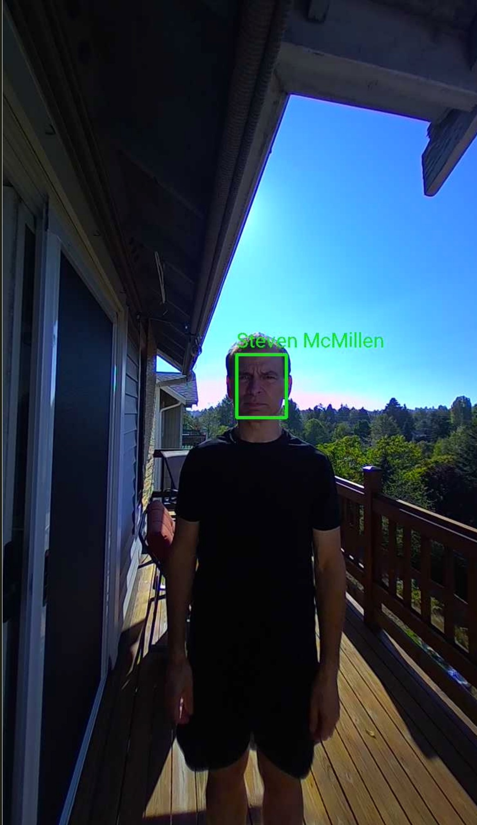
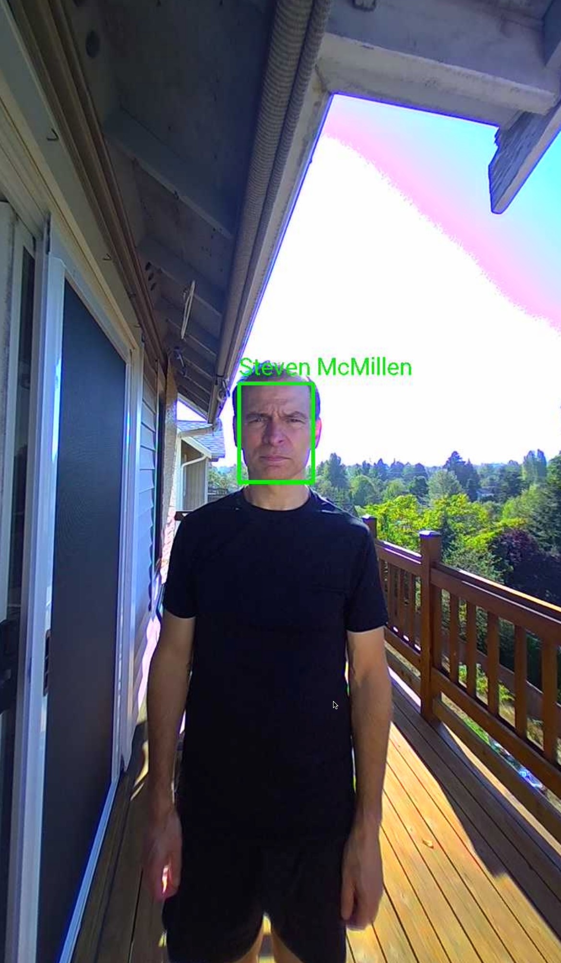
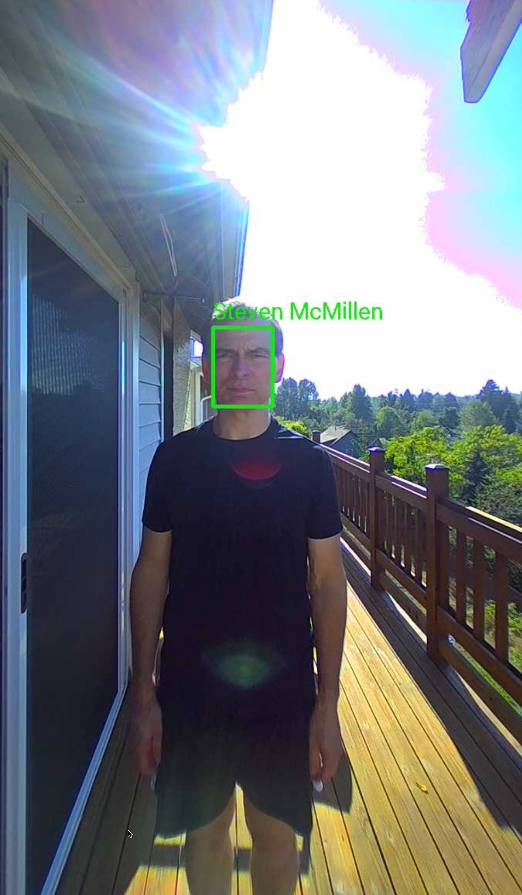
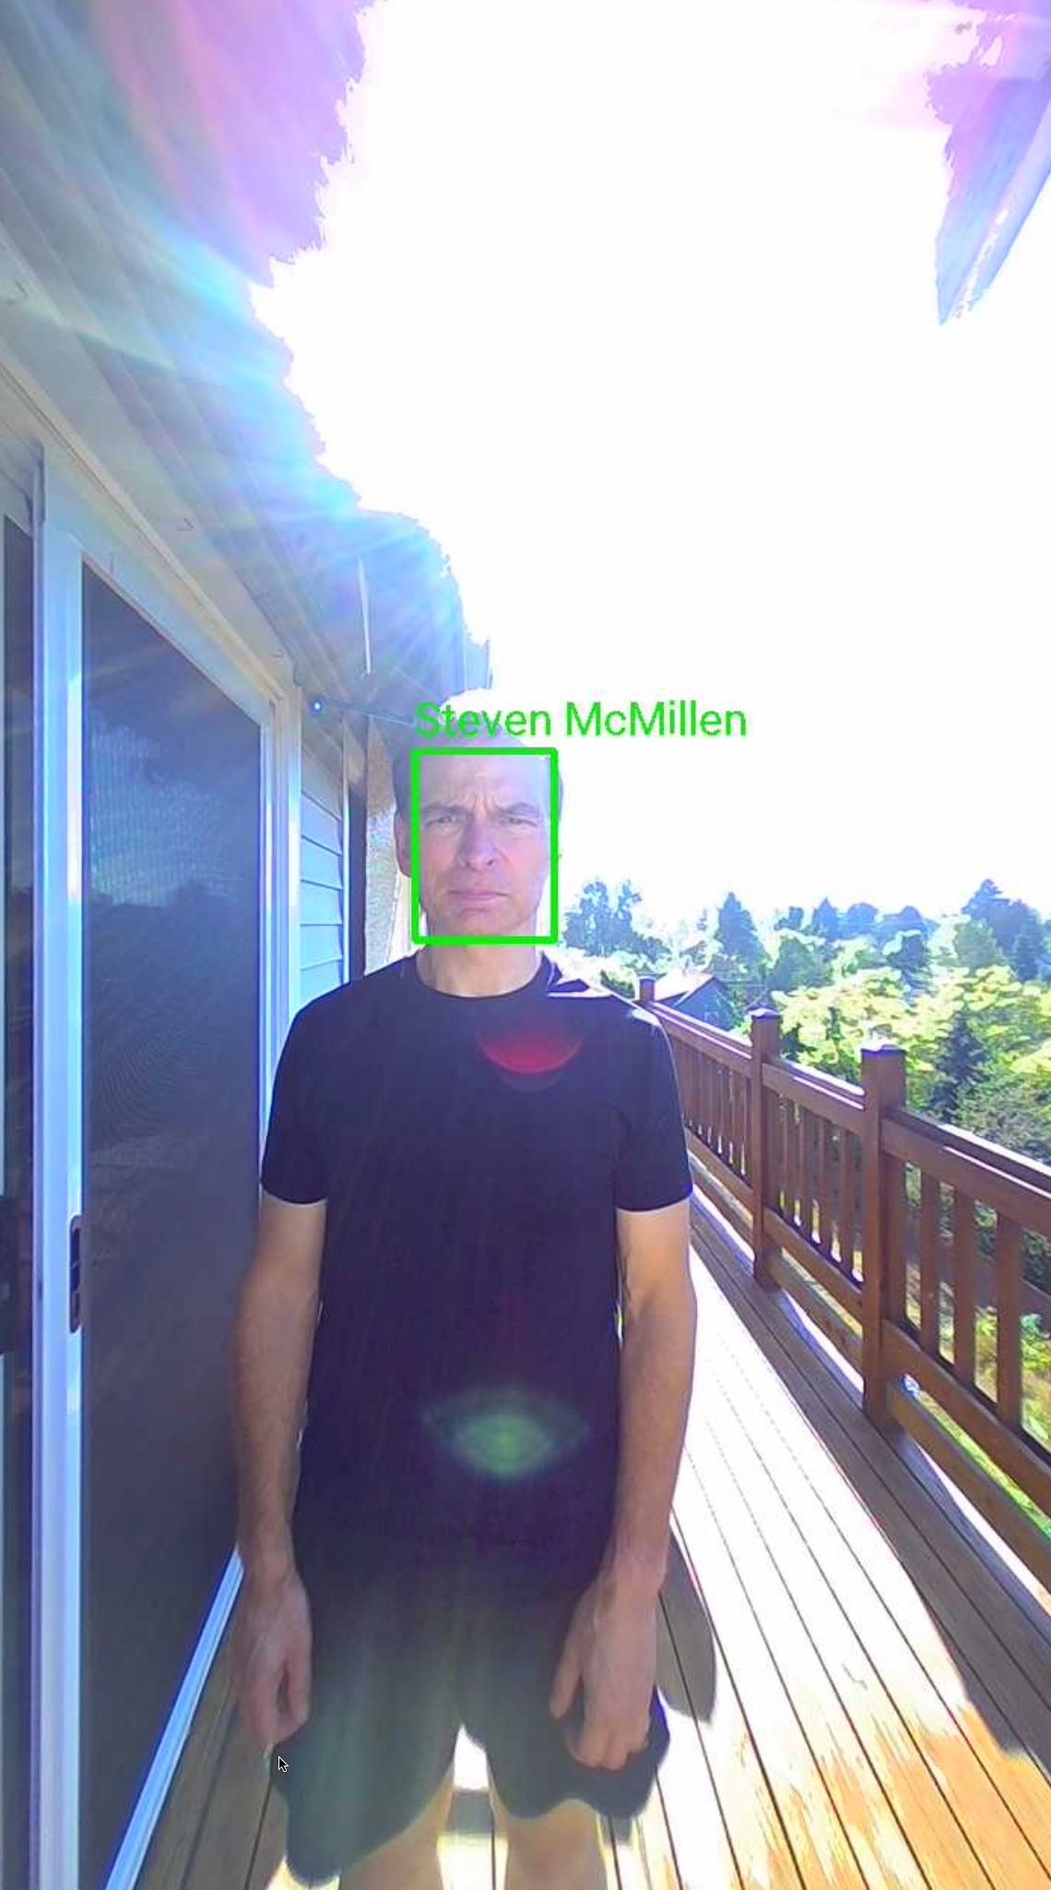
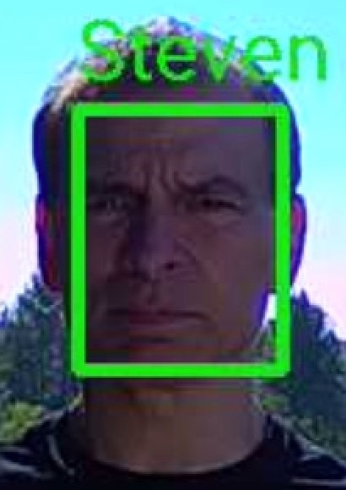
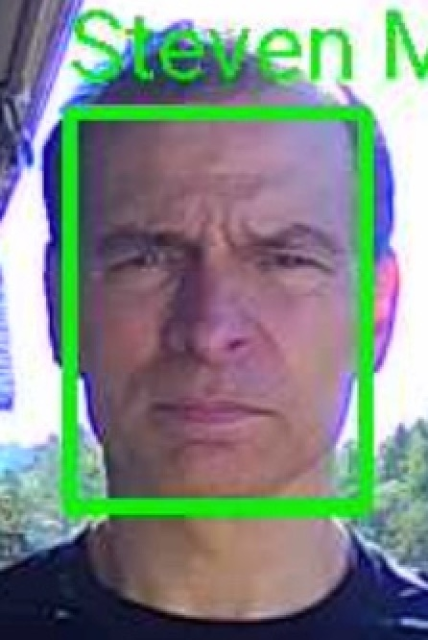
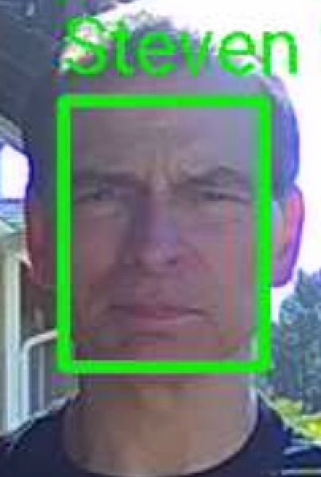
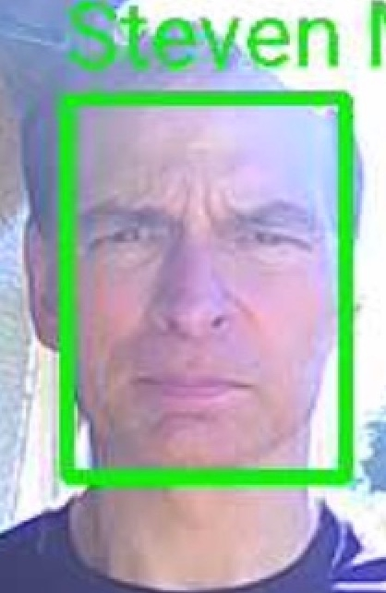
Performs well with harsh lighting conditions
Face priority auto exposure for strong backlighting or direct sun.
Indirect Sun
Direct Sun
Standard HDR
Face Priority
Standard HDR
Face Priority
Vs.
Vs.
Better with SAFR’s Face Prioritized exposure
Better with SAFR’s Face Prioritized exposure

Slide 16

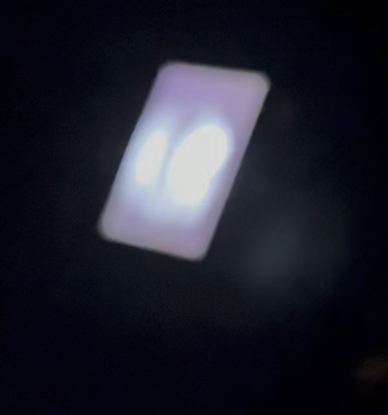
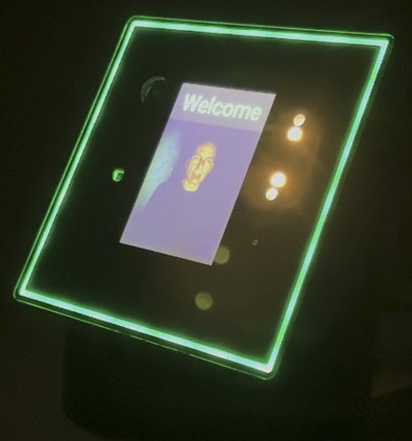
Performs well with zero light
SAFR SCAN use a combination of strategies to handle low light
  Applies IR illuminator to perform face recognition in low light.
  Applies white light sources on front panel to illuminate the face.
Initial State - Zero Light
Face Detected via IR
Face Match using white light
SAFR SCAN is in waiting state using IR to search for faces.
SAFR SCAN detects a face and screen lights up. It first tries to do face matching with IR.
When IR face matching fails, it fades in the white lights and face matching succeeds.

Slide 17


Robust Anti-Spoofing Technology
SAFR SCAN incorporates 2 types of liveness technologies to combat presentation attacks
Structured Light 3D Liveness
RGB Liveness
The SAFR SCAN Anti-Spoofing Difference
A.k.a. Presentation Attack Detection (PAD)
Many liveness technologies can be easily spoofed with simple high-resolution images manipulated to create the illusion of a 3D face.
3D
The SAFR SCAN uses a specialized SLP (Structured Light Projector) to conduct a 3D liveness evaluation on the subject.
RGB
As a secondary analysis, SAFR SCAN uses SAFR’s unique RGB Liveness technology that analyzes the texture and context of the RGB image to determine liveness.

Slide 18
Hardware
SAFR SCAN packs a lot of functionality into the hardware. This section describes the hardware components and their function.
Notes:
SAFR SCAN is powered in what way?
( ) PoE Class 3 Ethernet
( ) Auxiliary Power 12V DC
(x) Both
( ) Neither
SAFR SCAN can be powered from either PoE or 12V DC. The two can even be used in parallel providing redundant power.
Which of the following explains why SAFR is able to handle bright lighting conditions?
( ) Smoked glass ensures that full strength light does not hit the sensor.
(X) Software control over exposure to ensure best lighting on face.
( ) Sun shield to ensure no direct sun on the lens.
How does SCAN ensure the white lights do not result in a negative user experience?
( ) Leave the white lights on continuously so the person's eyes get acclimated to the bright light.
(X) Fade in the white light gradually.
( ) Only use IR unless there is already other lighting.
Which of the following does SAFR SCAN Support?
[X] Relay Circuits (Normally open/closed dry contact)
[X] OSDP Input/Output
[X] Wiegand Input/Output
[ ] Door State
[ ] Request to Exit
Door state to detect Door Forced Open/Door and other similar abilities will be enabled via firmware update in a release in the near future.
Where is the Reset button located?
[ ] Next to the Aux plug on back of device.
[ ] Upper left inside mounting bracket slot (must remove mounting bracket to access).
[X] All of the above
[ ] None of the above
The rest button exists in two different locations depending on the SAFR SCAN housing. While functionally both models are the same, the reset button differs between the two.
Select the right process for how to reset SAFR SCAN to factory defaults.
( ) Power off the device, Hold reset button in back for 8 seconds until the device shows flashing red.
( ) Power off the device, Hold reset button in back for 15 seconds until the device shows solid red.
( ) Power on the device, Hold reset button in back for 8 seconds until the device shows flashing orange.
(X) Power on the device, Hold reset button in back for 8 seconds until the device shows solid red.
Later we will also cover how to reset the device from the browser interface.
What functions does the Video Display serve?
[X] PIN Pad to allow user to key in code.
[X] Text feedback such as "Too close" or prompts for 2nd factor.
[X] Live video feedback so user knows device has activated and processing.
[ ] Show Green/Red ring for access granted/denied.
Green/Red feedback is handled by the LED ring around the edge of the device.
Which outdoor rating does SAFR SCAN support?
( ) IP55
(X) IP65
( ) IP68
SCAN is protected from all dust and low pressure stream of water though it is recommended to keep device out of direct rain.
Identify 2 Hardware components that are included but not yet enabled as of Jun-2023.
[ ] Structure Light Emitter
[X] Accelerometer
[ ] Touch Screen
[X] Microphone
SAFR SCAN ships with some hardware which is not yet enabled via firmware. Microphone is present but awaiting firmware update to enable 2-way SIP. Accelerometer is present but awaiting firmware update to detect if device is struck or moved.
When implemented, SAFR SCAN will support which of the following tamper checks?
[X] Motion - Any movement regardless of slowly.
[X] Shock - Sudden impact or jolt.
[ ] Temperature out of range.
SAFR does not have Temperature sensors but its range is large enough (-40F to 122F) that it may not be needed.

Slide 19
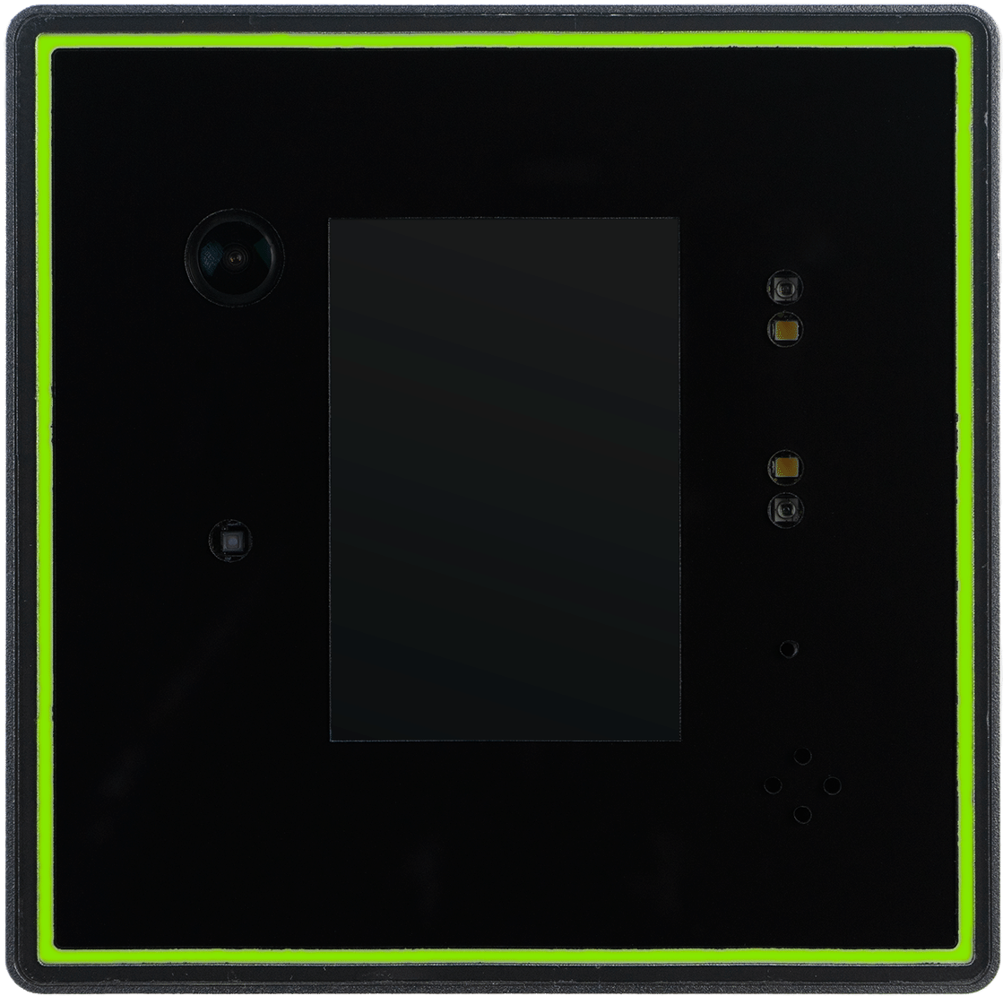

Device Features and Capabilities
Camera
  1920x1080 high quality camera
  Software control over exposure to ensure best lighting on face
Structured Light emitter
  Structured light to measure 3D Depth for spoofing detection
IR Projectors
  Useful in face detection in low/no light conditions.
  First line of defense for recognition in low light
White Light Projectors
  Useful in conditions with insufficient lighting
  Light will fade in to shine light on the face if other measures fail
Video Screen
  Video screen provides visual feedback to user such as “Too far” or “Scan badge” for Multi-factor use cases
Touch Screen
  PIN Pad for 2nd or 3rd factor authentication
  Call to speak button to initiate intercom features (roadmap)

Slide 20
Device Features and Capabilities
Light Ring
  LED Light Ring for user feedback
  Configurable colors, brightness and duration
Weatherproof enclosure
  IP65 rating for outdoor use
  Rated for -40°F to 122°F
Tempered Glass
  IK8 rating for vandal resistance
Accelerometer for Tamper Protection¹
  Detect shock or if device is moved and trigger alarms
Speaker & Microphone¹
  Provide audible user feedback (i.e. access granted, tailgating detected)
  Firmware update to provide intercom features
    Push to talk
    Remotely operate speaker
RF Card Reader
  Standard model (SFR-SC200-RF-L) with DESFire Ev1, EV2, LEAF and Mifare Classic
  HID model (SFR-SC200-RF) also supports HID iClass and Seos
  13.56 MHz compatible
  RFID 26, 34, 35, 37-Bit, Custom up to 254 Bits
1. Feature to be released with firmware update

Slide 21
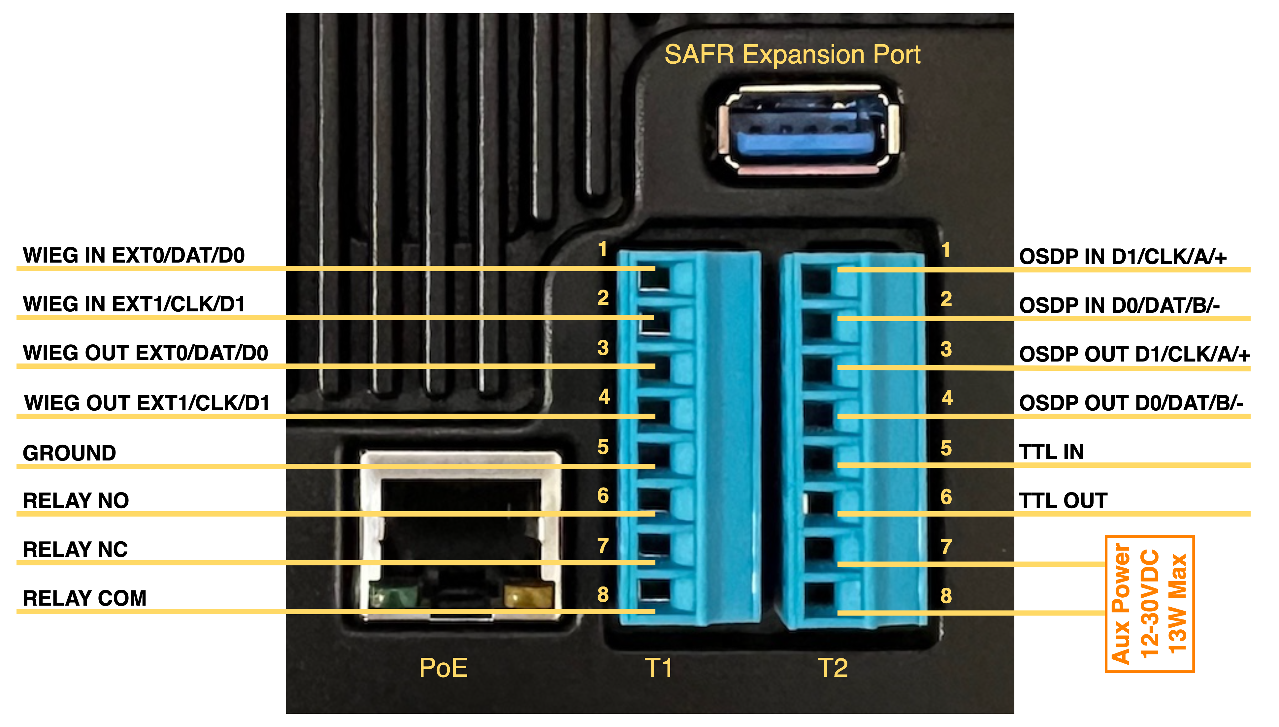
Rear Panel Terminal Connections
Connect to break out box to bring connections to secure side of door
Wiegand Inputs/Outputs
OSDP Inputs/Outputs
Shared Ground
+5 VDC used to trigger LED on external Reader
NC/NO Relay
(Normally Open
/Closed)
24 VDC / 1 Amp
Power
12 VDC @ 1 Amp / 24 VDC @ 0.5 Amp (13.1W)
Polarity reversible
PoE Class 3 (12w)

Slide 22
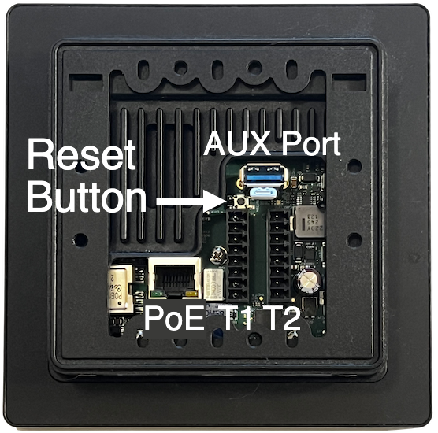
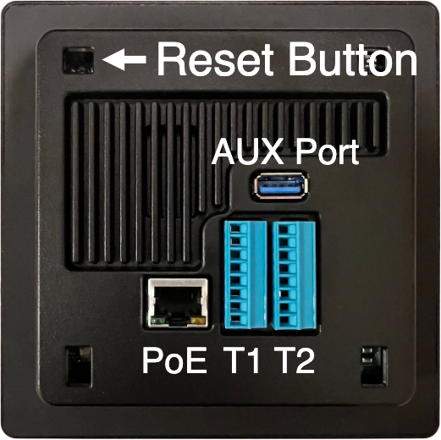

Factory Reset
Factory reset button location varies by housing as shown below.
Hardware Factory Reset will remove all personal data including network configuration and admin credentials.
v1 Housing
v2 Housing
Reset Procedure:
For v2 housing, remove mounting bracket to access Reset Button located inside the mounting bracket slot.
Power device on (connect to PoE or connect 12V to T2 terminal block ports 7 & 8).
Press reset button for 8 seconds.
Process is done when solid red light around the AUX Port.

Slide 23
How it Works
This section demonstrates the flow for granting access to a known authorized person.
Notes:
SAFR SCAN does not display Access Granted message until control panel authorizes access?
(X) True
( ) False
SAFR SCAN can be wired to monitor for access granted/denied signal from PACS Panel and enable LED to match panel's disposition.
SAFR must have a network connection in order to match a face and grant access?
( ) True
(x) False
Person and credentials are pre-loaded on the reader and updated at intervals allowing SAFR SCAN to match faces and grant access without network.
Video feedback may be disabled on SAFR SCAN to address privacy concerns?
(X) True
( ) False
SAFR SCAN display can be configured to show a person silhouette in place of the live video feedback for cases where users do not like to see their face echo'ed back on the screen.
Only the physical access control can unlock the door latch?
( ) True
(X) False
The Normally Open or Normally Closed dry contact relay ports on SAFR SCAN can be used to activate a door lock.

Slide 24
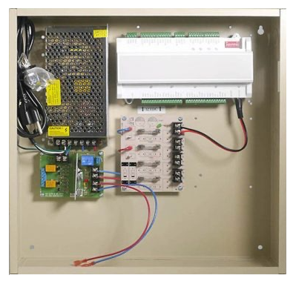
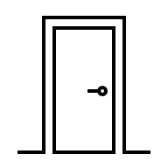


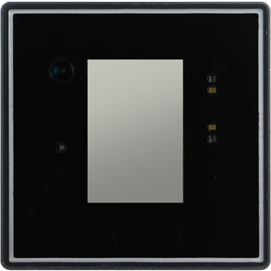
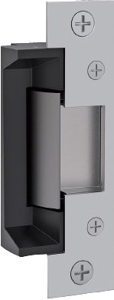

How it works - Enroll
Enroll
Waiting
Match Face
Transmit Credentials
Grant Access
Unlock Door
Detect Face
Panel Evaluates
Enroll faces and credentials and synchronize to SAFR SCAN readers. Identities are stored locally on the device for fast matching even if network offline.
Identity/Credential Management System
More later about the many options for enrollment.

Slide 25
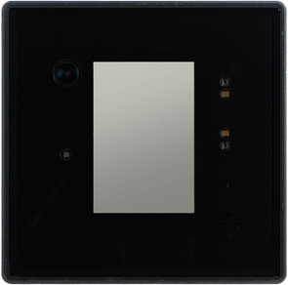
How it works – Waiting
Enroll
Waiting
Detect Face
Transmit Credentials
Grant Access
Unlock Door
Match Face
Panel Evaluates
In the background, SAFR SCAN continuously monitors for faces in view of the camera. Device maintains low power mode but processes up to 30 frames each second scanning for faces.

Slide 26
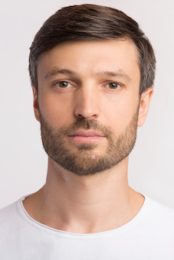

How it works – Detect Face
Enroll
Waiting
Match Face
Transmit Credentials
Grant Access
Unlock Door
Detect Face
Panel Evaluates
Once SAFR SCAN Detects a face, it turns on the display and begins to provide user feedback. The face is extracted from the video and compared to the database of identities for a match.
(Video display may be disabled to address privacy concerns)

Slide 27

How it works – Match Face
Enroll
Waiting
Match Face
Transmit Credentials
Grant Access
Unlock Door
Detect Face
Panel Evaluates
If a match is found, SAFR SCAN retrieves person credentials. Person record includes name and access clearance and credentials.
(If not found Access Denied message shown)

Slide 28
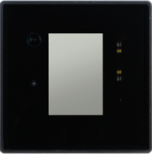
How it works – Transmit Credentials
Enroll
Waiting
Match Face
Unlock Door
Detect Face
Grant Access
Panel Evaluates
Transmit Credentials
SAFR SCAN checks local access clearance rules (schedule, # guests, ...). If authorized per local access clearance rules, credentials are sent to the Panel via OSDP or Wiegand.
(If using Door Relay, door unlock is triggered directly)
Facility, Badge ID

Slide 29
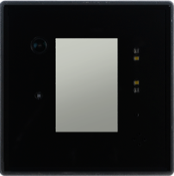
How it works – Transmit Credentials
Enroll
Waiting
Match Face
Grant Access
Unlock Door
Detect Face
Panel Evaluates
Transmit Credentials
Physical Access Control Panel evaluates access based on the PACS rules.

Slide 30
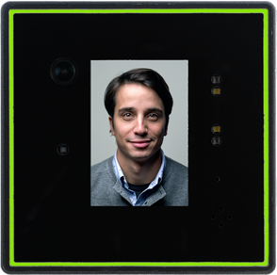
How it works – Transmit Credentials
Enroll
Waiting
Match Face
Transmit Credentials
Grant Access
Unlock Door
Detect Face
Panel Evaluates
Physical Access Control Panel returns Access Granted or Access Denied signal over Wiegand (via red/green LED wires) or OSDP.
SAFR SCAN displays Access Granted or Access Denied depending on response
Access Granted
(or Denied)

Slide 31


How it works – Unlock Door
Enroll
Waiting
Match Face
Transmit Credentials
Grant Access
Unlock Door
Detect Face
The Physical Access Control Panel sends +12VDC to the electric door latch which opens the latch and unlocks door.
Facility, Badge ID & Location ID
+12 VDC

Slide 32
sales@safr.com
www.safr.com

